Slide 1
Assignment on WWW AND iNTERNET
Submitted to :-
Sandeep Kaur
Submitted by:-
Name – Vikash Kumar
Roll no.-1610024

Slide 2




INTERNET
The Internet is the world's largest network
Basic services of Internet
Eg. E-mail,FTP,TELNET.
Uses of Internet :
Online communication,
software sharing,
World Wide Conferencing
Some popular Internet search engines

Slide 3
INTERNET SERVICE PROVIDER
An Internet service provider (ISP) is an organization that provides services for accessing, using, or participating in the Internet.
Internet services typically provided by ISPs include Internet access, Internet transit, domain name registration, web hosting, Usenet service, and colocation.
ISPs also provide their customers with the ability to communicate with one another by providing Internet email accounts, usually with numerous email addresses at the customer’s discretion

Slide 4

Responsibility of ISP
Providing and maintaining a connection to the internate
Provide 24 Hour customer service and technical support
To protect their site and network from external threats such as viruses, hacker attackes and other activity

Slide 5

WEB BROWSER
A web browser, or simply "browser," is an application used to access and view websites
The primary function of a web browser is to render HTML, the code used to design or "mark up" webpages

Slide 6

URL(Uniform Resource Locator)
A uniform resource locator (URL) is the address of a resource on the Internet.
A uniform resource locator (URL) is the address of a resource on the Internet.

Slide 7
A URL contains the following information:
The protocol used to a access the resource
The the location of the server (whether by IP address or domain name)
The port number on the server (optional)
The location of the resource in the directory structure of the server
A fragment identifier (optional)

Slide 8
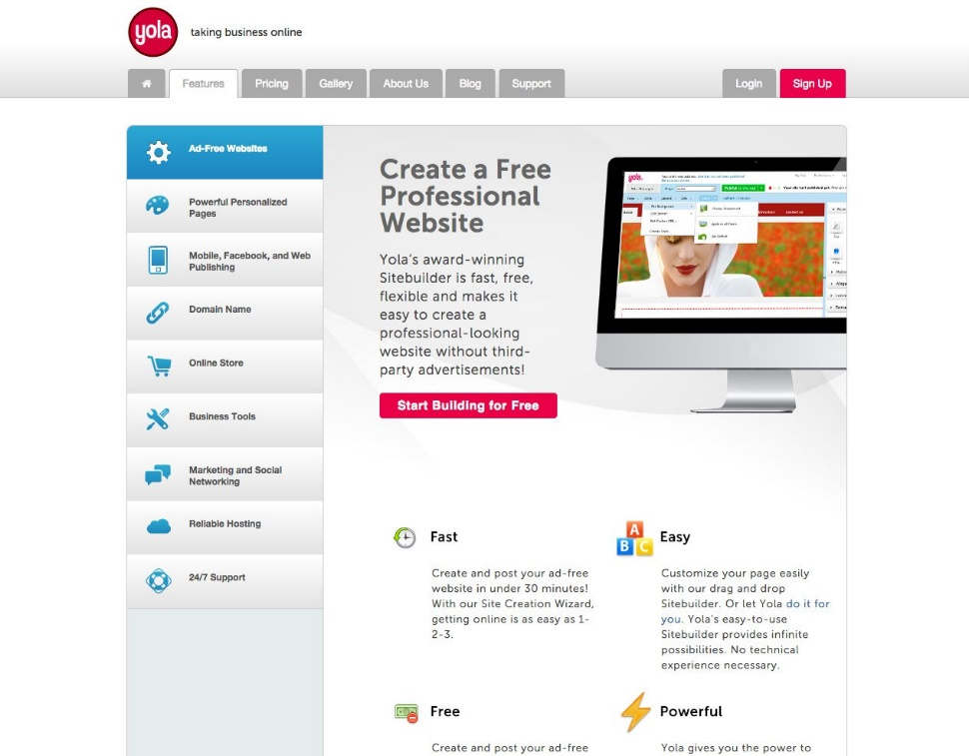
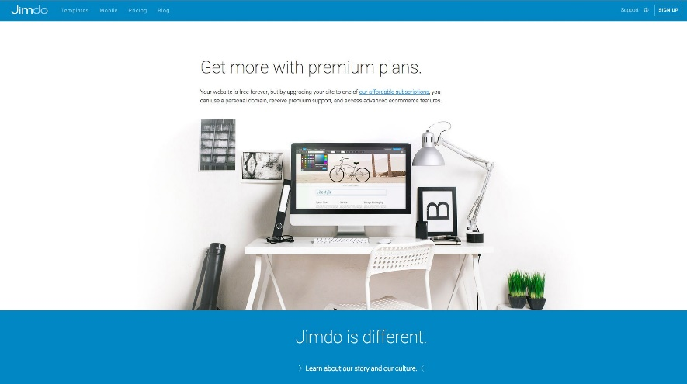
Web Creations Tools
Yola
Jimdo

Slide 9

World Wide Web
The World Wide Web, also known as the WWW
WWW is an information space where documents and other web resources are identified by URL
The World Wide Web (WWW) is combination of all resources and users on the Internet that are using the Hypertext Transfer Protocol (HTTP).

Slide 10
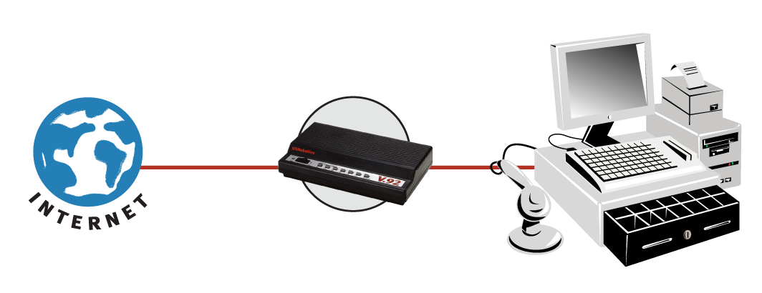
Internet Connection
There are many ways a personal electronic device can connect to the internet.
Different Types of Internet Connections
Dial-Up (Analog 56K).

Slide 11
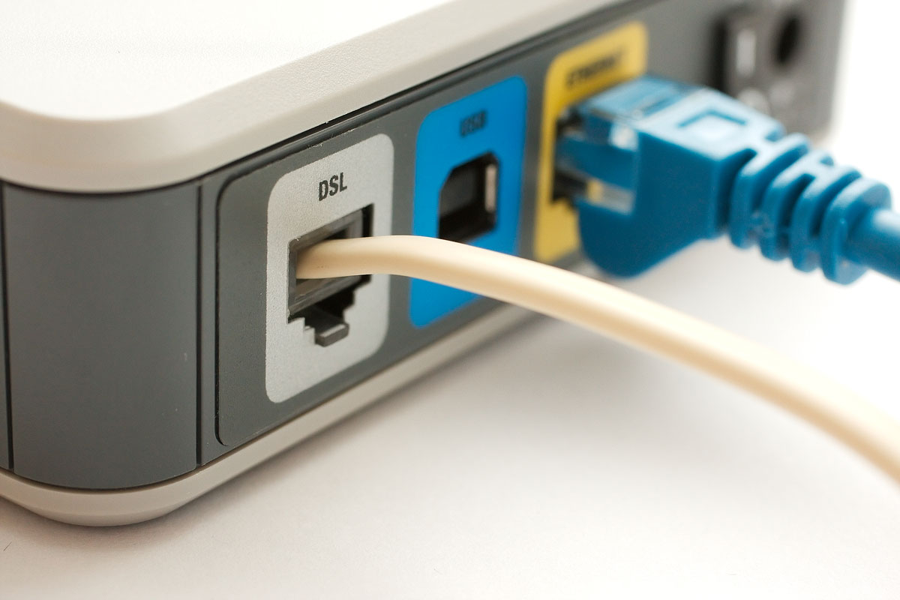
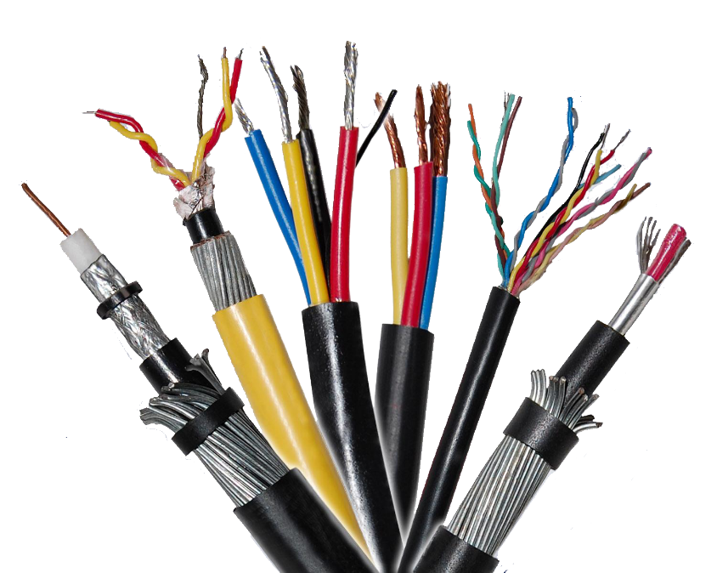
DSL.
Cable.

Slide 12


Wireless.
Satellite.

Slide 13

Cellular.

Slide 14
Thank you

